Slide 1



DATA ANALYTICS
Project Presentation
GROUP NO: 05

Slide 2



Slide 3

TEAM MEMBERS
SAMARTH RAJENDRA PES1UG20CS370
SANATH N BHARGAV PES1UG20CS372
SANKALP CB PES1UG20CS589

Slide 4
ABSTRACT AND SCOPE
Our model aims at making agricultural predictions for a specific region in the Indian Subcontinent, by using historical data, thus enabling better agricultural yield.
This method uses the data of twelve previous years, taking a monthly average thus countering the seasonality that occurs every ten years.
This model gives predictions using a metric called the normalized difference vegetation index (NDVI).
NDVI is the most widely used vegetation index for retrieval of vegetation canopy biophysical properties.
NDVI is adopted to analyze remote sensing measurements and assess whether the target being observed contains live green (photosynthesizing) vegetation or not.

Slide 5
IMPLEMENTATION DETAILS
DATASET:
Collection of Data from NASA’s EarthData.
Data from previous twelve years has been considered.
Transformations of HDF files to retrieve NDVI values.
Using the HDFView application to convert the HDF of NDVI to csv sets.
LIBRARIES USED:
Pandas
Numpy
Matplotlib
Tenserflow
keras
Gradio.

Slide 6
IMPLEMENTATION DETAILS
MODEL:
Training to be done using LSTM and Dense layers.
METRICS:
LOSS = Mean squared error.
Optimizer = ADAM.
USER INTERFACE:
Gradio.

Slide 7
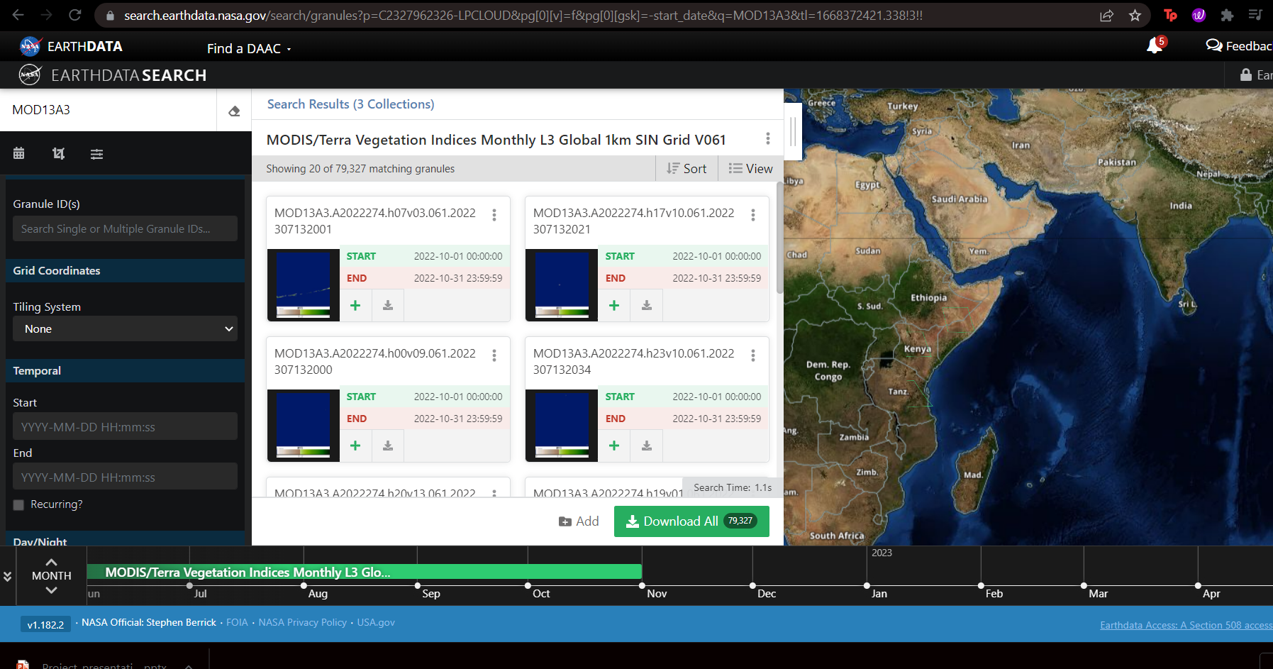
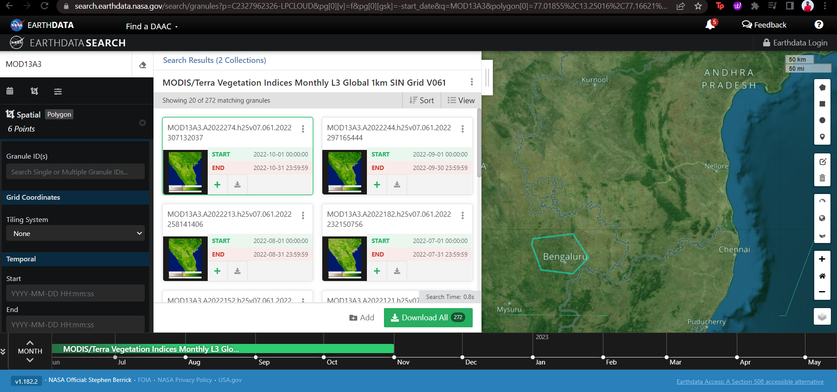
PROJECT DEMONSTRATION
DATASET COLLECTION
Earthdata – MOD13A3 HDF DATA DOWNLOADS FOR A SMALL PART(polygon)

Slide 8
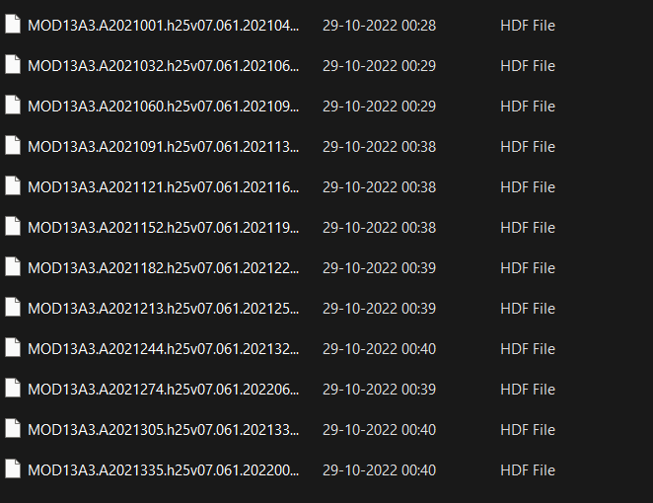
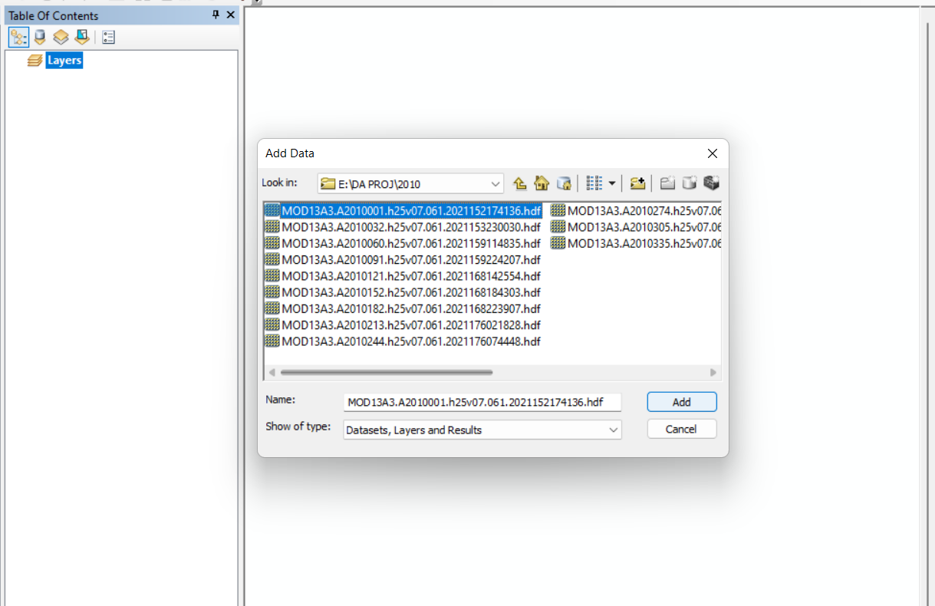

PROJECT DEMONSTRATION
ARCMAP for gathering NDVI
All HDF downloads for every year Adding data for the layers in ARCMAP

Slide 9
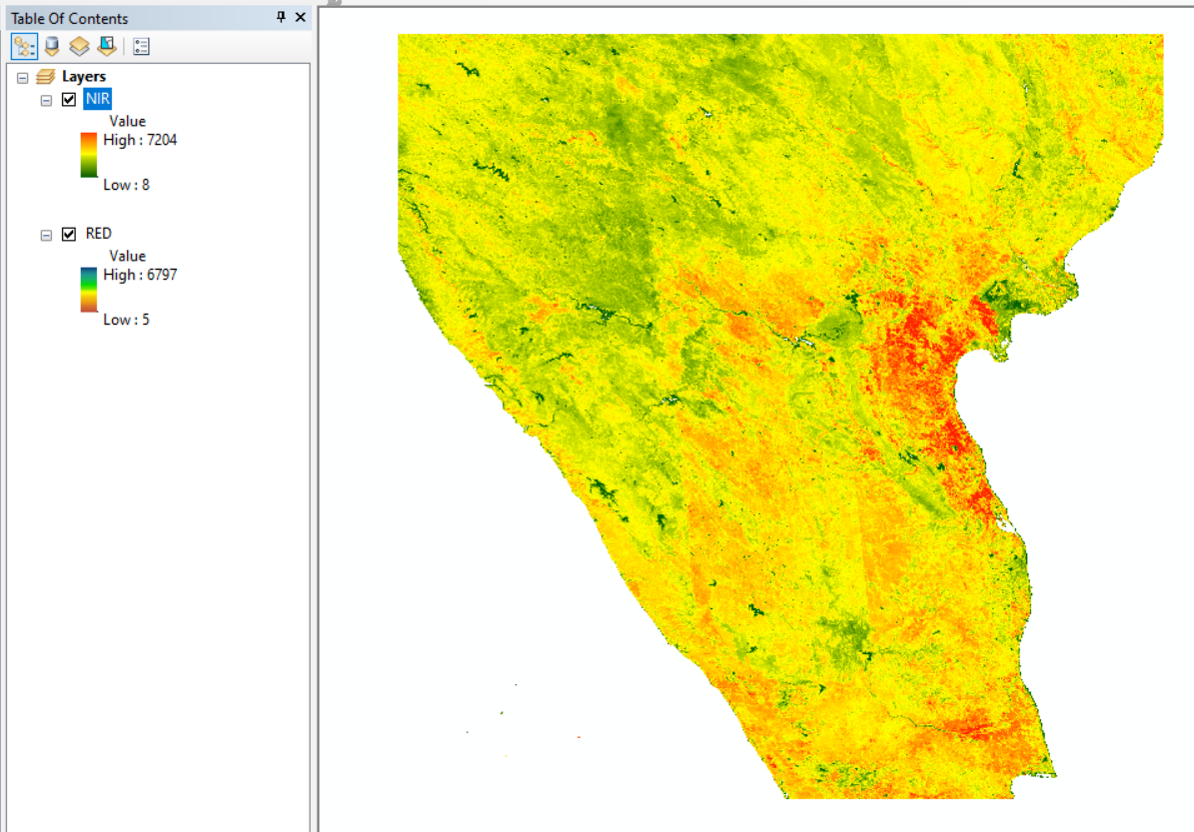
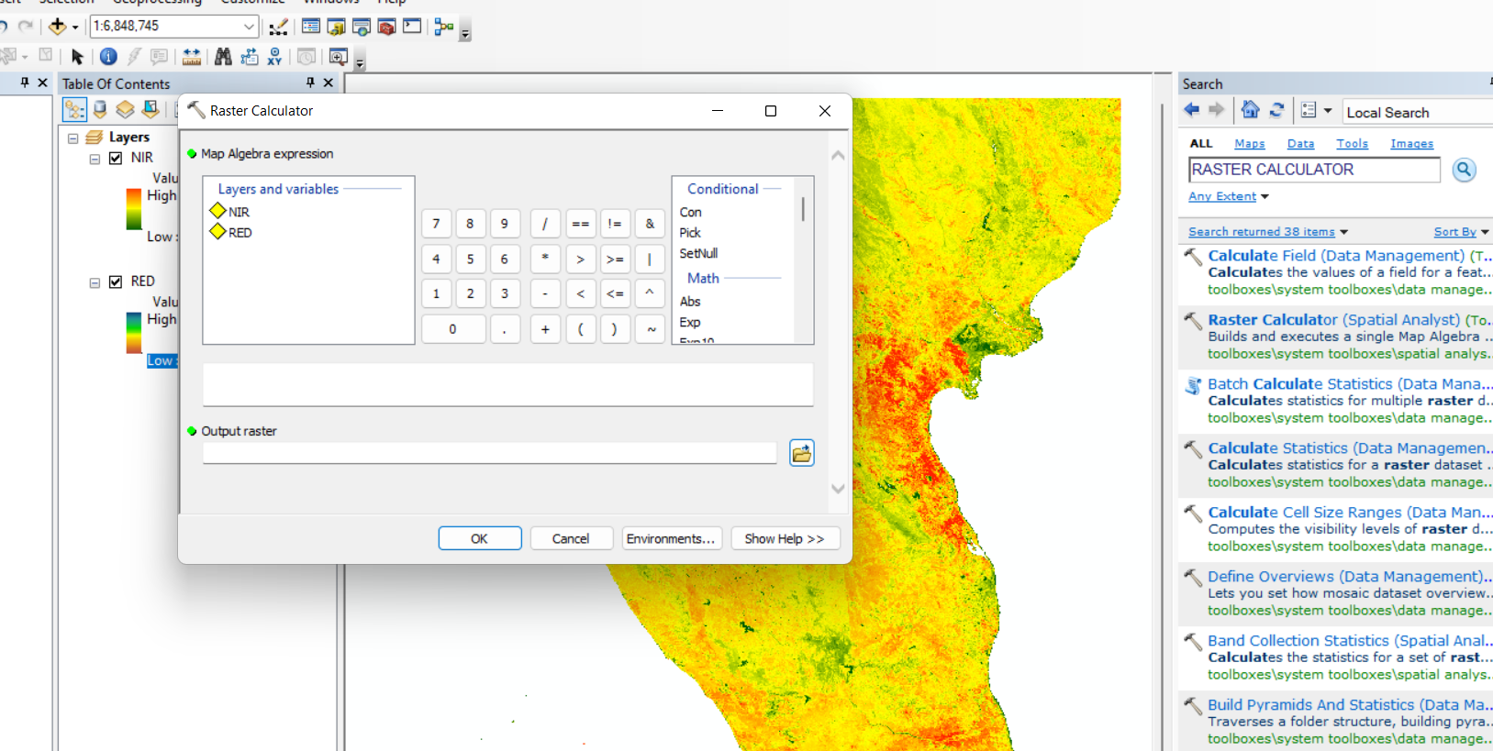
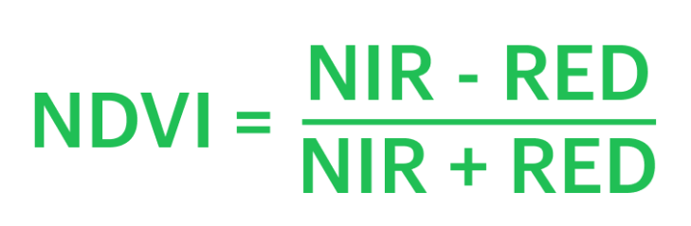
PROJECT DEMONSTRATION
The Rasters of NIR and Red bands are taken as input
The output NDVI is calculated using the formula given

Slide 10
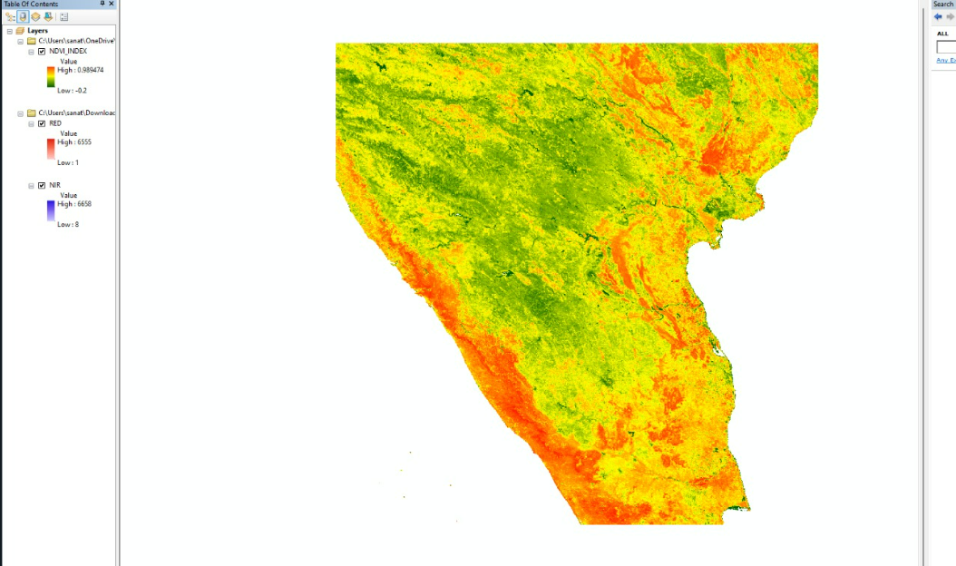
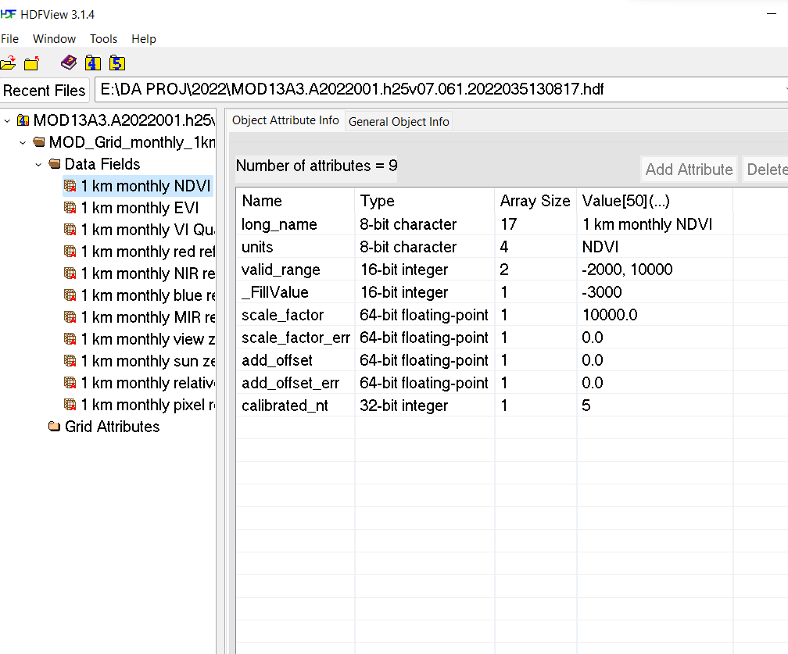
PROJECT DEMONSTRATION
NDVI layer
HDF from NDVI layer is used in HDFView

Slide 11
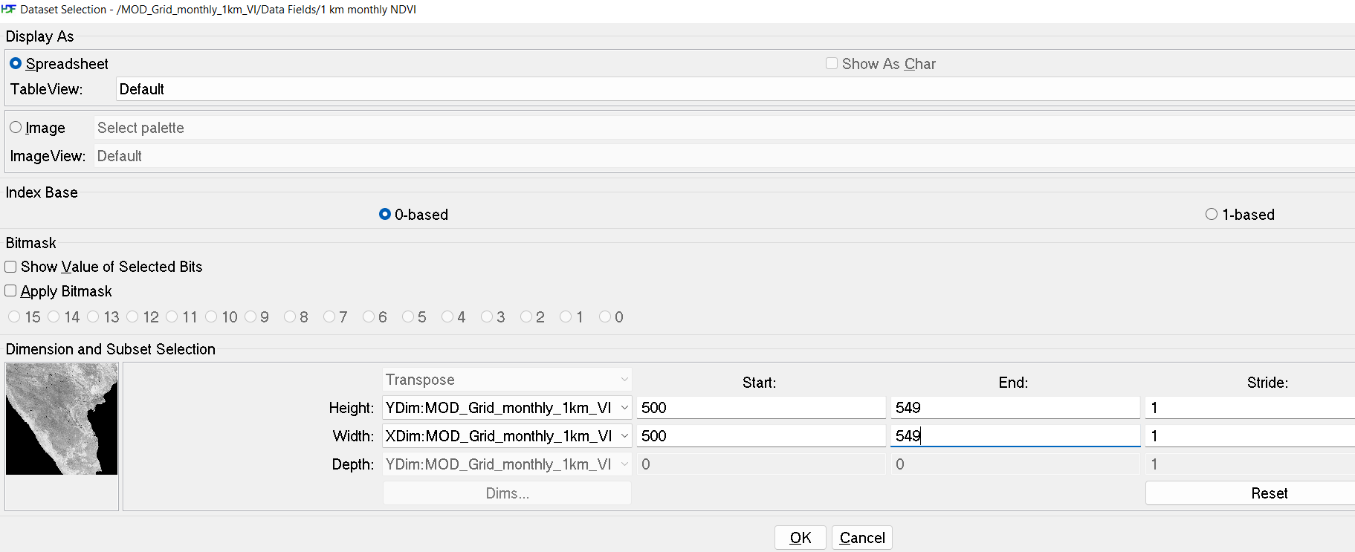
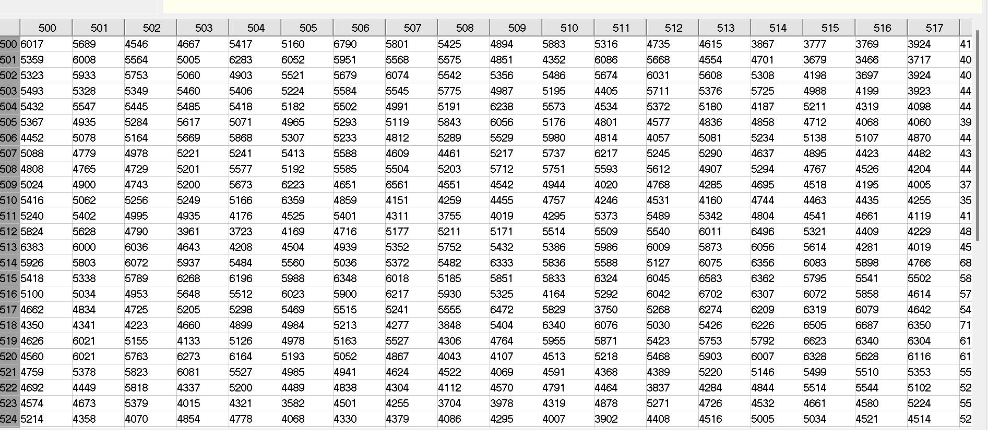
PROJECT DEMONSTRATION
NDVI MATRIX EXTRACTION (csv) for range (500-549)

Slide 12
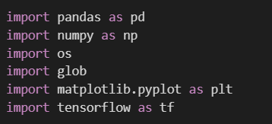
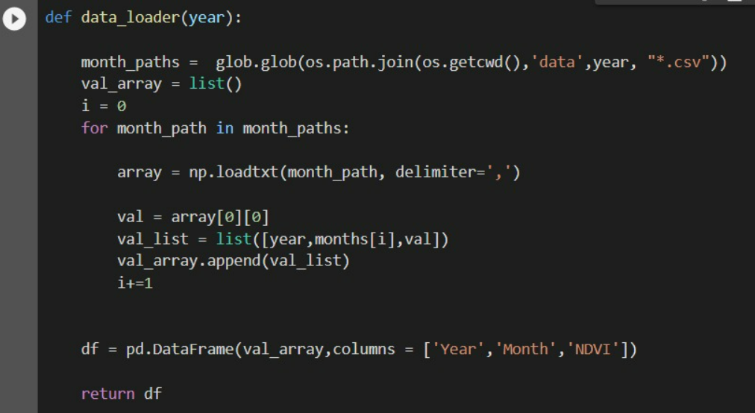
PROJECT DEMONSTRATION
Libraries Used
Function to load the data into dataframe

Slide 13
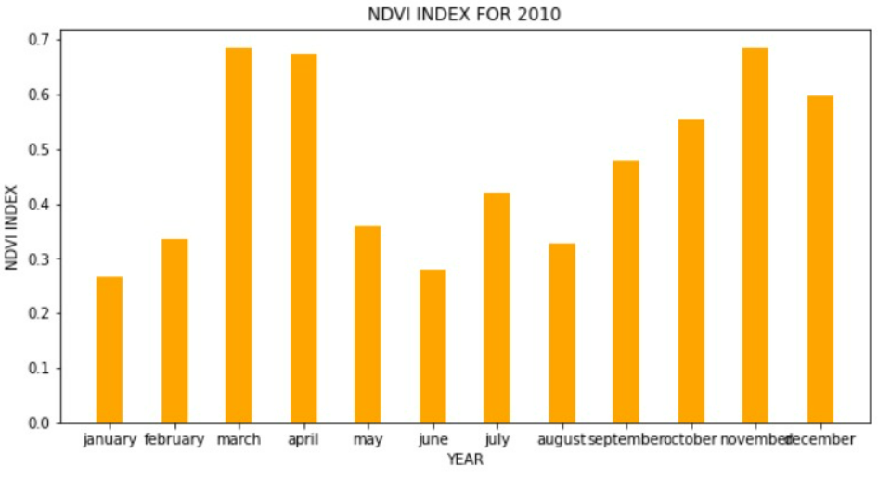
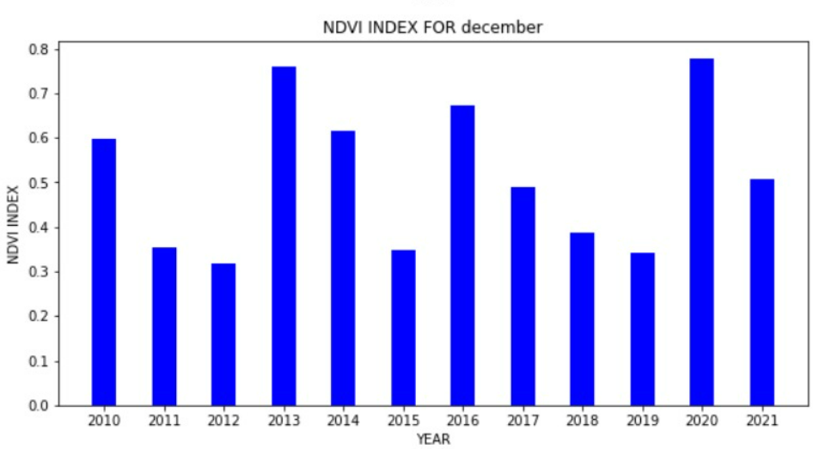
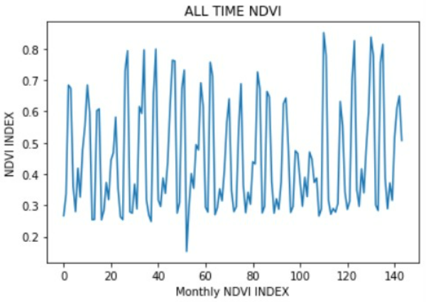
PROJECT DEMONSTRATION
Analysing and Plotting the DATA

Slide 14
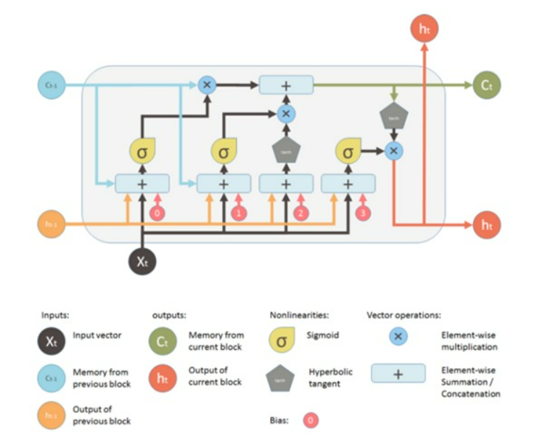
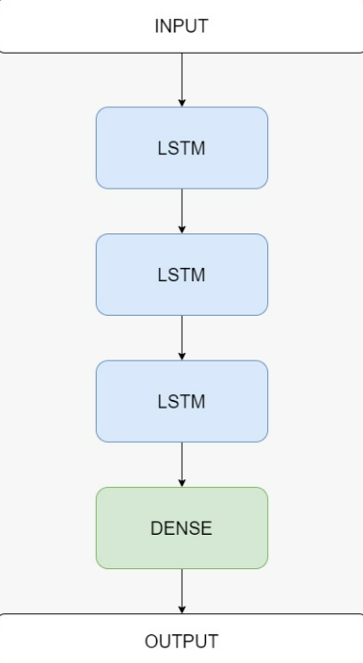
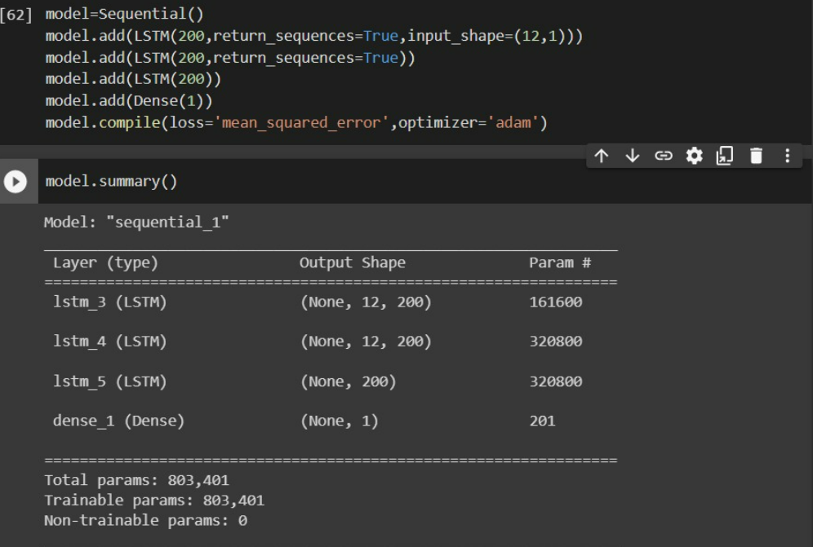
PROJECT DEMONSTRATION
LSTM Building Blocks
Model Architecture

Slide 15
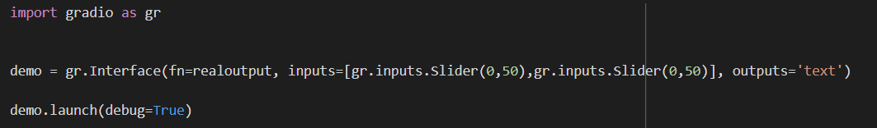
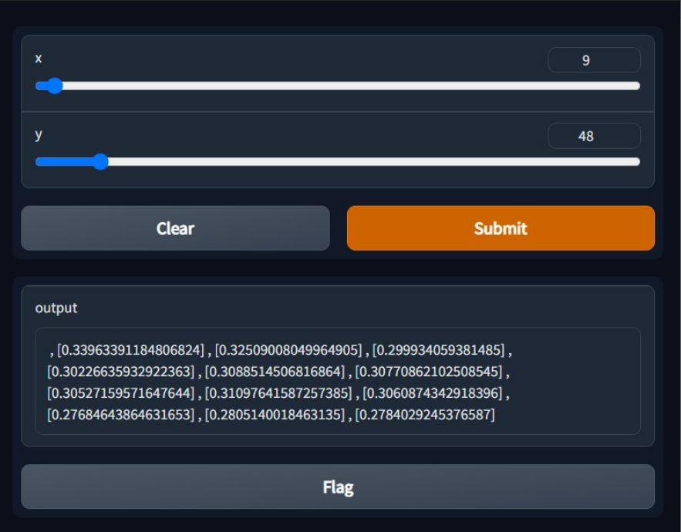
PROJECT DEMONSTRATION
<= Code implementation
USER INTERFACE
<= X – Y coordinates as Inputs
<= Predicted Values for next twelve months as Output

Slide 16
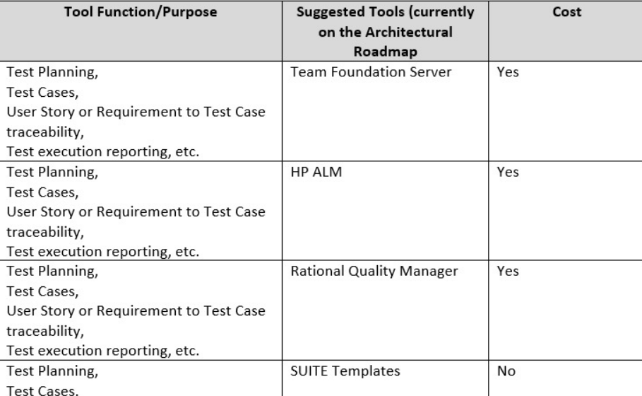
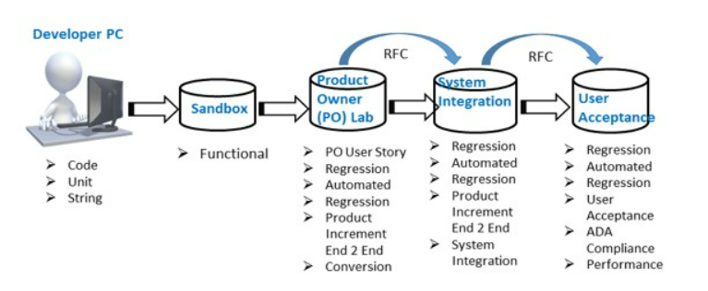
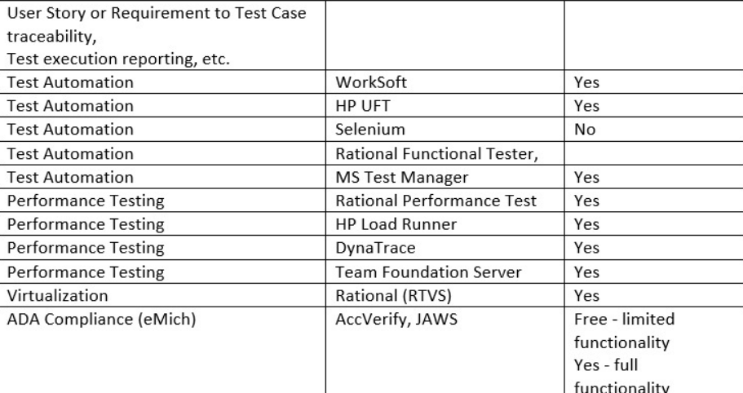
TEST PLAN AND STRATEGY
Block wise testing of all the code blocks and functions.
TO BE IMPLEMENTED

Slide 17
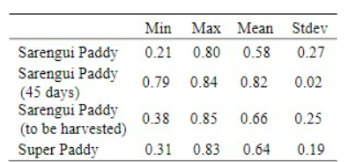
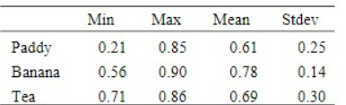
RESULT AND DISCUSSION
As shown in the figure, basic user interface is implemented to provide the predictions for the next twelve months.
The model, when trained over two hundred epochs, gives a root mean squared error loss of 0.0844 over the training data and a root mean squared error loss of 0.12 over the test data.
Crops suitable for respective NDVI values

Slide 18
CONCLUSION AND FUTURE WORK
Through this project, it is demonstrated that the NDVI values for a particular location can be predicted using a learning model.
Given the crops that can be grown on a given set of NDVI values, accurate predictions can be made as to which crop can be cultivated at a given location , thus enabling the farmer to increase his yield.
This would be beneficial to the farmers of our state Karnataka since very few implementations have been made here.
In Future, we can create an application that will extract the location and give accurate predictions using the historical data for the location.
Provide Real-time analytics which help the agricultural experts to make better predictions which in turn helps the farmers.

Slide 19
REFERENCES
1. Ahmadi H, Nusrath A, “Vegetation change Detection of Neka river in Iran by using remote sensing and GIS”, Journal of geography and Geology,
2 (1)., pp. 58-67., 20122. Karaburun A. A. K. Bhandari, “Estimation of C factor for soil erosion modelling using NDVI in Buyukcekmece watershed”, Ozean Journal of applied sciences
3, 77-85., 2010.3. Chouhan R, Rao N," Vegetation detection in Multi spectral remote sensing images: protective Role-analysis of coastal vegetation in 2004 Indian Ocean Tsunami. Geo-Information for Disaster Management ”, Procedia Technology 6, pp., 612 – 621., 2012.
4. Xie Y, Zhao X, Li L, Wang H,” Calculating NDVI for landsat7-etm data after atmospheric Correction using 6s model: a case study in Zhangye City, China, In proceeding IEEE Geo Informatics 18th international conference, pp. 1-4., 2010.
5. Hu Y, Ban Y, Zhang X, Liu J, Zhuang. D,”Spatial- temporal pattern of GIMMS NDVI and its dynamics in Mongolian Plateau”, In IEEE Proceeding on earth observation and remote sensing applications, pp.1-6., 2008.
6. Merwan Achibeta, Stefan Balevb, Antoine Dutotb, Damien Olivierb,” A Model of Road Network and Buildings Extension Co-Evolution Agent-based Modeling and Simulation of Cities Procedia Computer Science”, 32, pp. 828 – 833. 2014
7. Shikhar Deep , Akansha Saklani, ” Urban Sprawl modeling using cellular automata” , The Egyptian Journal of Remote Sensing and Space Sciences, 17, pp. 179–18., 2014.
8. A.K. Bhandari, A. Kumar, “Feature Extraction using Normalized Difference Vegetation Index (NDVI): A Case Study of Jabalpur City”, Proceedings of Communication, Computing & Security. Procedia Technology Volume 6, pp. 612– 621, 2012.9. Nageswara PPR, Shobha SV, Ramesh, KS, Somashekhar RK,” Satellite -based assessment of Agricultural drought in Karnataka State, Journal of the Indian society of remote sensing “, 33 (3), pp. 429-434., 2005

Slide 20
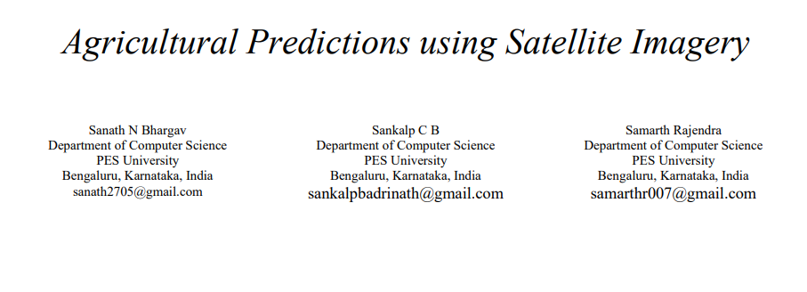
IEEE DRAFT
Paper to be Published
Sanath N Bhargav , Sankalp CB, Samarth Rajendra ,” Agricultural Predictions using Satellite Imagery”: Using NDVI.

Slide 21


